Slide 1
Understanding by Design
DESIGNING
CURRICULUM & INSTRUCTION
Notes:
Understanding by Design is a way of thinking about teaching and learning. It asks us to plan with the end in mind.
Backward Design is not new. It is an efficient way to plan for student achievement – if we want more than knowledge and skills. If we want students to understand and transfer that learning. Which is truly what we have in mind when we talk about academic achievement.

Slide 2
Mission informs schooling.
Schooling should enable learners to achieve worthy intellectual accomplishments. Learners should be able to transfer their learning with understanding to worthy tasks and develop mature habits of mind.
Notes:
Thinking with the end in mind is really having us think about our mission as educators. Most of us if not all of us are familiar with writing mission statements as part of our work with accreditation.
Although a LOT has been written about education and school reform and the importance of having a mission, “mission” do not always inform schooling.
Over the last few years PDE has been involved in far-reaching reform initiatives. They have reformed teacher certification, have revised their standards, and have made other reforms using what Wiggins & McTighe call Backward Design.
Backward Design is a result of the longstanding work of David Perkins on understanding and learning.
That means we are schooling by design.

Slide 3
Schooling By Design
USE BACKWARD DESIGN
Curriculum & Assessment System
Mission Learning Principles
Policies,
Structures,
Governance, Resource Allocation
Personnel – Hiring, Appraisal, Development
Instructional Programs & Practices
Apply Strategic Principles
Notes:
PDE has set up a STANDARDS ALIGNED SYSTEM. Their goal is to align curriculum with assessment. They have adopted Understanding by Design and Schooling by Design as a means of constructing a standards aligned system.
They are attempting to systematize curriculum & instruction to ensure results. As the website went up they put up lesson and unit plans as exemplars but iin the rush to do so, they have made mistakes due to the lack of understanding of what Wiggins & McTighe mean by backward design.
This is the whole picture of what PDE has undertaken. Schooling by Design is something we can achieve. This morning we will look at one piece – using backward design to plan curriculum and instruction.

Slide 4
WHY?
WHAT?
By keeping the end in mind we plan more efficiently for
student acquisition of knowledge and skills as well as for their ability to transfer that knowledge and skill to new situations with power and perspective.
Notes:
Our goal today is to become familiar with what Backward Design is and how we go about employing it in planning for better student achievement.
WHY learn about this? Feedback from the high schools about lack of critical thinking and depth of understanding of our elementary students.
If we contend that schools exist to develop and deepen students’ understanding of important ideas and processes,
equipping them to transfer their learning in meaningful and effective ways and cultivating lifelong habits of mind, then we must utilize more efficient and effective practices.
To accomplish this mission, our curriculum and units and lessons must be built backward from the meanings and the transfer we seek.

Slide 5


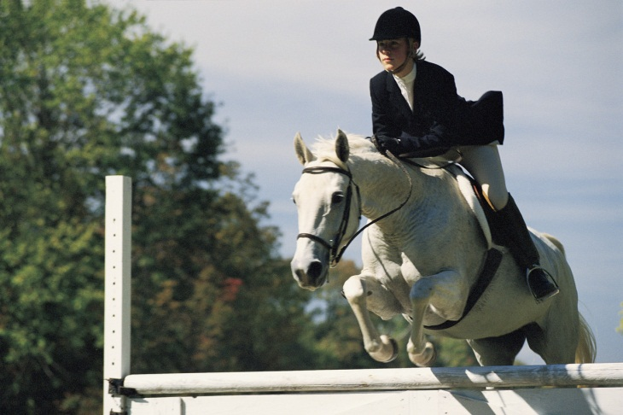
Understanding understanding
What is understanding?
How do you gain understanding?
How do you know you know?
Notes:
What do we mean when we say we want students to understand the content, not just know it?
What is the difference between really “getting it” and just regurgitating back what was taught?
ACTIVITY
We personally have revealed how learning for understanding was achieved -
Motivation to learn.
Practice and feedback.
Experience was constructivist in nature: social, active, creative (assimilation or adaptation), reflective.
Acknowledgement, sense of achievement within/from a group.

Slide 6

A private universe
What are my students really getting out of this class?
How can I tell if my students are harboring common misconceptions?
How do I know they not simply know but understand?
Notes:
BUT that’s not what always happens in a classroom.
Provide other examples of holding on to misconceptions.
How do we know they have these?
Is it a matter of how we assess?

Slide 7
Difficulty
One of many agendas
Little collegial support for process
What curricula? What assessments serve as evidence of understanding? What learning activities best support understanding?
Notes:
TWIN SINS of educators:
ACTIVITY directors
COVERAGE, no depth

Slide 8


BACKWARDDESIGN
Desired Results
Evidence
Learning experiences
Notes:
TEACHING is a means to an end and PLANNING can make teaching efficient and effective.
Counterintuitive

Slide 9


1.Desired Results
Science Curriculum
Scientific Literacy
Have sufficient knowledge of science and engineering to engage in public discussions on science-related issues.
Be critical consumers of scientific information related to their everyday lives.
Be able to continue to learn about science throughout our lives.
Recognize that our current scientific understanding of the world is a result of hundreds of years of creative human endeavor.
Notes:
Backward Design can be developed for :
Programs
Units
Lessons
Point of learning anything is to make it your own, to have it culminate in a new power and perspective. These are the goals worked out by the Science Curriculum Committee for our elementary science program. These are long term goals and as elementary teachers we want to teach so that these are realized.
When we think about learning, we have to consider:
TRANSFER – Students should be able to apply to new situations w/flexibility and fluency
MEANING MAKING – Students should be able to draw conclusions, make connections, explain conclusions in own words.
ACQUISITION – To make meaning and transfer what they have learned they need knowledge and skills acquired over time.

Slide 10
But WHAT should we teach?
Big ideas and Core Tasks
Important to know and do
Worth being familiar with
Notes:
LOTS.
PRIORIZE.
HOW?
Use of a filter.
Provide examples.

Slide 11
How does one go about determining what is worth understanding amid a range of content standards & topics? Wiggins & McTighe, 1998, p.10
  To what extent are the content standards and topics enduring and transferable big ideas, having value beyond the classroom?
  To what extent are the content standards big ideas and core processes at the heart of a discipline?
  To what extent are the content standards and topics abstract, counterintuitive, often misunderstood or easily misunderstood ideas requiring uncoverage?
  To what extent are the content standards and topics big ideas embedded in facts, skills, and activities?
Notes:
These are how to discern what is critically important, to select what to teach.
Provide examples of core concepts and fluff within lessons, units.

Slide 12
Enduring Understanding
  Enduring, big ideas having lasting value beyond the classroom.
  At the heart of the discipline
  Abstract, counterintuitive, and often misunderstood.
  Embedded in facts, skills, and activities.
  Scientific knowledge develops through carefully controlled investigations.
  The scientific method deliberately isolates and controls key variables. (It is not simply trial and error.)
Scientific Method
Notes:
Let’s look at how the science committee would determine if this topic was worthy of inclusion in our curriculum.
Walk through filters.
Therefore, these are the conclusions or generalizations we would plan for the students to gain by the end of the unit.

Slide 13
Inquiry
Essential questions drive the unit, the lessons.
Is the scientific method the best means to investigate?
Does scientific discovery always rely on the application of the scientific method?
How does someone ensure that the results of scientific investigations are valid?
Notes:
CRITICAL.
When we focus on coverage, we tend to be in TELLING mode.
Learning must be engaging. BUT not just a series of fun activities.
We must pose ESSENTIAL QUESTIONS.
Note qualities of essential questions.
Explain why these are essential questions for a unit on the scientific method.
Explain how units, lessons should be driven by questions to ensure more of an inquiry approach.
Importance in engaging students in inquiry, questioning what they know and what they are learning.
Engaged in assimilating/adapting new ideas into their schema.

Slide 14



2.Evidence
Performance Task
Notes:
SO how can we prove that they know and understand?
Collect evidence over time.
We can judge the transferability of core ideas, knowledge, and skill when we give students CHALLENGING tasks.
Typically, tasks are designed around questions, problems .
Although we can incorporate performance tasks at various points in a unit, to judge understanding at the end of a unit, we’d look at creating performance assessments BECAUSE understanding is revealed in performance. AND performance assessments take a lot of time – the for student and for you as teacher.
For science, given the conclusions or generalizations about scientific method which we want students to gain. eighth grade students should be able to explain how they can ensure that the results of their scientific investigation are valid.
How do I know they have an understanding of what that entails and that they have the knowledge and skills to do so? By their ability to design and debug an experiment without being dishonest or self-deceiving about the data collected and analyzed.
Emphasize USE OF RUBRICS – Given at outset. Guide for students, evaluation instrument for teacher.

Slide 15

FACETS OF UNDERSTANDING
6
  Can the student explain? Do they have a working theory about the topic?
  Can they interpret a text or event of data set in a contextualized way?
  Can they apply what they understand to another situation?
  An they argue for another perspective simultaneously with having their own perspective?
  Can they develop and show empathy for a character or historical period of time?
  Can they use their self-knowledge to recognize their biases?
Notes:
When we think about understanding we need to recognize that there are 6 facets of understanding.
Identify what we use moat of the time.
Distinguish between perspective and empathy. Example of when they are used.
Self-knowledge is also important.
NOT THE SAME AS BLOOM’S TAXONOMY.

Slide 16
Assessment Continuum
Observations & dialogues
Informal checks
Tests & quizzes
Academic prompts
Performance tasks
Notes:
Performance tasks can occur during the learning as checkpoints for understanding but performance assessments typically occur at the end of a unit. Students DEMONSTRATE that they understand.
Teachers develop and use a rubric to guide the students and to make clear the competencies and the depth of understanding they have achieved.
SO the culminating performance assessment require a LOT from students and teachers. We must pick and choose when we include these. The content and its transfer would be VERY important.
BUT we need to assess throughout the learning process.
Formative to inform planning and judge progress in students’ being able to draw conclusions we intend.
We need to look at assessment as a Photo Album or scrapbook showing the progress and the achievement of each student.
Check for understanding of academic prompts.

Slide 17
3. Learning Experiences
STUDENTS
TEACHER
social
active
creative
Universal Design
CONTENT
ACTIVITIES
Interventions
reflective
Notes:
LAST STEP is to plan instruction.
Explain palette of teacher as artist. Choices that must be made.
We must select activities that will be most effective in helping students achieve desired results.
Instruction must be coherent. Everything leads to accomplish of goals/objectives.
Align desired result, assessment, and all learning experiences within unit, within lesson.
Selection must reflect what we know about learning.
Not simply hands-on. Explain importance of fourth piece which keeps activity form being just that an activity and not learning.

Slide 18
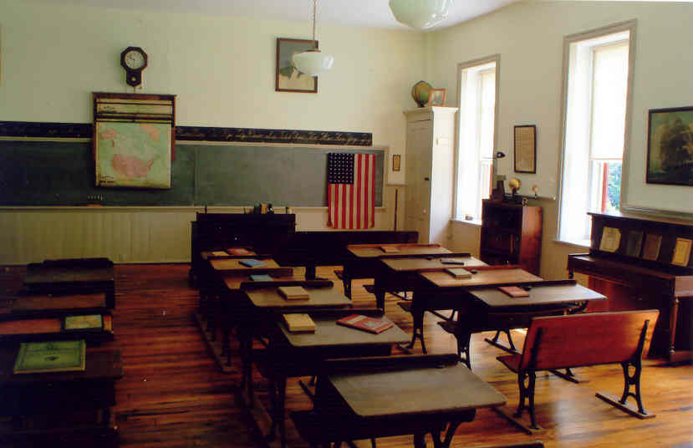


SWBAT explain how important it is to examine numerous artifacts - both primary and secondary sources - to construct an accurate history of one-room schoolhouse as explained in a multi-paragraph essay.
Notes:
Social Studies example of how an activity is coherent to goal/desired results, engaging students in doing work of historian (report cards, old photos. etc/.

Slide 19
Planning with the end in mind
1
Desired Results
What should students know, understand, and be able to do? What content is worthy of understanding?
2
Evidence
How will we know students have achieved the desired results? What will we accept as evidence of student understanding?
3
Learning Experiences
What enabling knowledge and skills will students need in order to perform effectively? What activities will equip them with that knowledge and those skills?
Notes:
In summary,
Review steps.

Slide 20

The purpose of planning is to achieve predictable results.
Notes:
Americans hold the notion that good teaching comes through artful and spontaneous interactions with students during lessons …
Such views minimize the importance of planning increasingly effective lessons and lend credence to the folk belief that good teachers are born, not made.
Every teacher can be effective. Every school can produce better results.

Slide 21
YOUR TURN
Notes:
At your tables,
Think in terms of a unit you love to teach.
What results would you want in terms of understanding and acquisition of knowledge and skills?
What could you use as a culminating activity?
What would you collect as evidence over time?
What activity would help in ensuring that the desired results were achieved?

Slide 22
Crafting Understandings
Phrased as a topic: CIVIL WAR
Underlying concepts: Causes & effects of the Civil War, states rights, federal government, economic advantage
Core concepts:
  The Civil War was fought primarily over states’ rights issues linked to differences in regional economies.
  The war’s effects live on in national politics, regional economies, and cultural differences.
Notes:
Teachers often say topics are the easiest to think of in terms of UbD.
Sample of topic.

Slide 23
Crafting Understandings
Phrased as a process: Converting to metric measures
Underlying concepts: measure, standard, accuracy, conversion
Big idea or core conclusion:
Standardized measures allow people to accurately describe the physical world.
We can measure the same thing with different measures (e,g., Fahrenheit and Centigrade)
Notes:
Sample of how a process can be thought of in terms of understanding

Slide 24
Crafting Understandings
Phrased as a skill: Persuasive writing techniques
Underlying concepts:
persuasion, goal, audience, influence, technique
Big idea or conclusion:
The choice of particular persuasive techniques depends on the goal (what you want people to do or believe) and audience.
Notes:
Sample of same for a skill

Slide 25
WHY?
WHAT?
HOW?
TRANSFER
By keeping the end in mind we plan more efficiently for
student acquisition of knowledge and skills as well as for their ability to transfer that knowledge and skill to new situations with power and perspective.
Notes:
We contend that schools exist to develop and deepen students’ understanding of important ideas and processes,
equipping them to transfer their learning in meaningful and effective ways and cultivating lifelong habits of mind.
I’ve pointed out why we need to use UbD – we must be aware of what PDE is doing, we must produce better results in order to compete and market our schools.
I’ve explained what UbD is and how it can be applied to programs, units, and lessons.
Now it is time to try to implement the process. It is not a recipe. It is a thought process.
To ensure better academic results in our classrooms – to carry out our mission, our curriculum and units and lessons must be built backward from the meanings and the transfer we seek.
Just take one unit you love to teach. Start plannig it with the end in mind.

